Slide 1
Business Data Communications & Networking
Chapter 9
Wide Area Networks

Slide 2
Outline
WAN Service Types
  Dedicated-Circuit Networks
  Packet-Switched Networks
  Virtual Private Networks
WAN Design Practices
Implications for Management

Slide 3
Wide Area Networks
Wide area networks (WANs) run long distances connecting different buildings or offices
  Organizations typically do not own all of the land upon which the WAN circuits run
  May span a city, regions, or even countries
Often built using leased circuits from common carriers
  e.g., AT&T, Sprint, Verizon, BT, Telefónica, Level 3, Tata Communications

Slide 4
Wide Area Networks
Common services
  Dedicated-circuit networks
  Packet-switched networks
  Virtual private networks (VPNs)

Slide 5
Dedicated-Circuit Networks
Use full duplex circuits from common carriers called leased lines or private lines to create point-to-point links between organizational locations
Carrier installs circuit that connects locations
Connect LANs to leased lines using modem, multiplexer, or channel service unit / data service unit (CSU/DSU)
Billed at a flat fee per month with unlimited use of the circuit
Adding/removing lines or increasing/decreasing capacity may be difficult, time consuming, and expensive

Slide 6
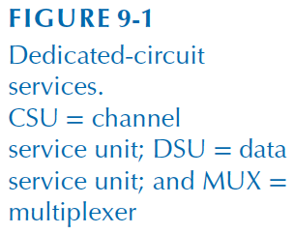
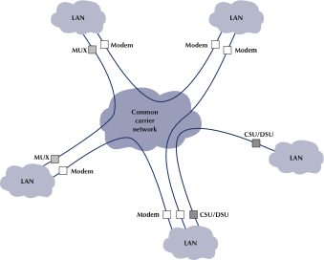
Dedicated-Circuit Networks

Slide 7
Dedicated-Circuit Networks
Three architectures (physical topologies) for dedicated-circuit networks
  Ring
  Star
  Mesh

Slide 8

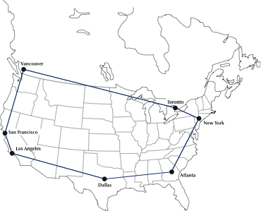
Ring Architecture

Slide 9
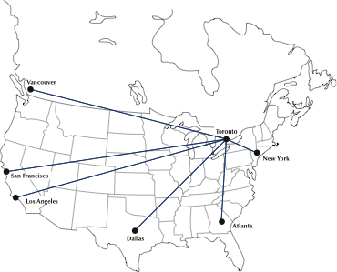
Star Architecture

Slide 10

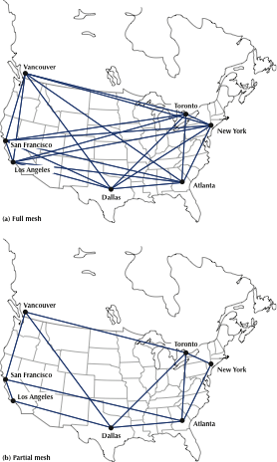
Mesh Architecture

Slide 11
Dedicated-Circuit Networks
Architecture | Advantages | Disadvantages
Ring | Robust to loss of any one circuit | Long routes may increase communication latency
Star | Simpler management Messages require 1 or 2 hops Circuit failure primarily affects a single site | Susceptible to traffic problems Failure of the central site will cause complete network failure
Mesh | Generally short routes Robust to the circuit loss or overloaded circuits | Expensive

Slide 12
Dedicated-Circuit Networks
Two types of dedicated circuit services:
  T-carrier network
  Synchronous optical network (SONET)

Slide 13
Dedicated-Circuit Networks
T-carrier services
  Most common dedicated circuit used in North America using copper wires
  Similar to E-carrier services in Europe
T-carrier Designation | Digital Signal Designation | Speed
Fractional T1* | DS0 | 64 Kbps
T1* | DS1 | 1.544 Mbps
T2 | DS2 | 6.312 Mbps
T3* | DS3 | 44.736 Mbps
T4 | DS4 | 274.176 Mbps
*Commercially available

Slide 14
Dedicated-Circuit Networks
Synchronous optical network (SONET)
  ANSI standard for optical fiber transmission
  Similar to synchronous digital hierarchy (SDH) used outside of North America
SONET Designation | SDH Designation | Speed
OC-1 | STM-0 | 51.84 Mbps
OC-3 | STM-1 | 155.52 Mbps
OC-12 | STM-4 | 622.08 Mbps
OC-48 | STM-16 | 2.488 Gbps
OC-192 | STM-64 | 9.953 Gbps

Slide 15
Packet-Switched Networks
Operate more like LANs and BNs than dedicated-circuit networks
Connect to carrier network using packet assembler/disassember (PAD)
  Translates messages between protocols
  e.g. Frame Relay Assembler/Disassembler
Customers pay a fixed price for a connection to the carrier and then a fee for the data transmitted

Slide 16
Packet-Switched Networks
Packets from separate messages may be interleaved to maximize efficiency
Permanent Virtual Circuits (PVCs) are connections between different locations in the packet network
  Make packet-switched networks act like dedicated circuit networks
Switched Virtual Circuits (SVCs) change dynamically

Slide 17
Packet-Switched Networks
Data rates
  Different locations may have different transmission speeds to the carrier network
  Customers specify the rates per PVC
  The committed information rate (CIR) is guaranteed by the service provider
  Packets exceeding the CIR up to the maximum allowable rate (MAR) may be discarded if the network becomes overloaded

Slide 18
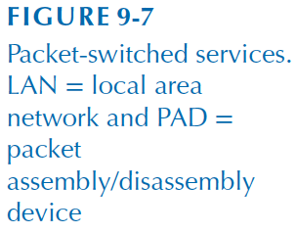
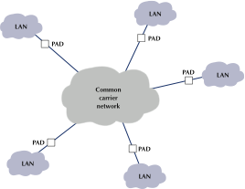
Packet-Switched Networks

Slide 19
Packet-Switched Networks
Types of packet-switched services
  Frame relay
  Ethernet
  MPLS

Slide 20
Packet-Switched Networks
Frame relay
  Flexible layer 2 standard for encapsulation and packet-switching in WANs
  Still common, but usage is declining
  Designed for high performance and efficiency
  Does not provide error control (unreliable)
Flags
(1 bytes)
Address
(2 bytes)
Data
(variable)
Frame Check Sequence (2 bytes)
Flags
(1 bytes)

Slide 21
Packet-Switched Networks
Ethernet
  Converting to and from LAN/BN protocols and WAN protocols slows communication
  Many carriers have switched or are switching to Ethernet for WANs
  These new packet services bypass the public switched telephone network (PSTN)
  May be less expensive than other alternatives

Slide 22
Packet-Switched Networks
Multiprotocol label switching (MPLS)
  Can be used with a variety of layer 2 protocols
  Label is applied when entering carrier network between layer 2 and layer 3 headers
    MPLS is sometimes called a layer 2.5 protocol
  Label is used in forwarding decisions and traffic engineering
  Packets can be switched using labels faster than using complete IP addresses and routing tables
Layer 2 Header
Label
(20 bits)
Traffic Class
(3 bits)
Bottom of Stack
(1 bit)
Time to Live
(8 bits)
Layer 3 Header

Slide 23
Packet-Switched Networks
Movement towards IP Services
  Telecommunications companies are moving towards “all IP” networks
  Replacing PSTN networks
  Ethernet and MPLS commonly used in these networks

Slide 24
Virtual Private Networks (VPNs)
Provide equivalent of private packet-switched network over the public Internet
Creates a virtual circuit often called a tunnel
May use dedicated hardware (VPN gateways) or be implemented in software
VPNs can be implemented at layer 2 or layer 3

Slide 25

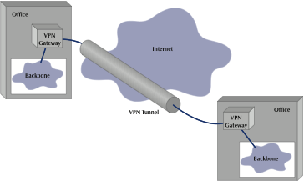
Virtual Private Networks (VPNs)

Slide 26
Virtual Private Networks (VPNs)
Intranet VPN
  Provides virtual circuits between organization locations over the Internet
Extranet VPN
  Same as an intranet VPN except that the VPN connects different organizations over the Internet
    e.g., customers and suppliers
Access VPN
  Enables employees to access an organization's networks from remote locations over the Internet

Slide 27
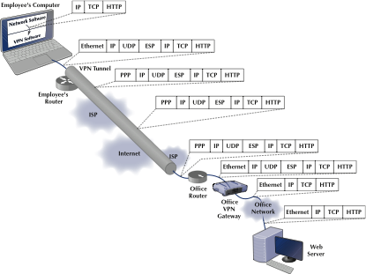
Virtual Private Networks (VPNs)

Slide 28
Virtual Private Networks (VPN)
Advantages
  Inexpensive
  Flexible
Disadvantages
  Internet traffic unpredictable
  Multiple incompatible implementations
    Not all vendor equipment and services are compatible

Slide 29
WAN Design Practices
Service | Data Rates | Relative Cost | Reliability
Dedicated-Circuit Services
T-Carrier | 64 Kbps to 45 Mbps | Moderate | High
SONET | 50 Mbps to 10 Gbps | High | High
Packet-Switched Services
Frame Relay | 64 Kbps to 45 Mbps | Moderate | High
Ethernet | 1 Mbps to 40 Gbps | Moderate | High
MPLS | 64 Kbps to 10 Gbps | Moderate | High
VPN Services
VPN | 64 Kbps to 50 Mbps | Low | Moderate

Slide 30
WAN Design Practices
Network Needs | Recommendation
Low to Moderate Traffic (10Mbps or less) | VPN if reliability is less important Frame relay otherwise
High Traffic (10-50 Mbps) | Ethernet or MPLS if available T3 if network volume is stable and predictable Frame relay otherwise
Very High Traffic (50 Mbps – 100 Gbps) | Ethernet or MPLS if available SONET if network volume is stable and predictable

Slide 31
Improving WAN Performance
Devices
Circuits
Demand

Slide 32
Implications for Management
Shift to Ethernet and MPLS
  Legacy technologies such as frame relay will be phased out like ATM
  Cost of WAN hardware and services decreasing
  Similar to LANs and BNs, WANs are experiencing standardization and commoditization

