Slide 1
Business Data Communications & Networking
Chapter 8
Backbone Networks

Slide 2
Outline
Components
Architectures
Switched Backbone Networks
Routed Backbone Networks
Virtual LANs (VLANs)
Best Practices
Implications for Management

Slide 3
Backbone Networks
High-speed network that connects other networks together (LANs, WANs)
Distribution layer BNs connect access LANs
Core layer BNs connect different buildings

Slide 4
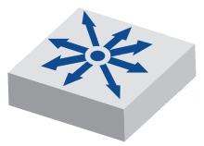
Backbone Network Components
Network cables (often fiber for higher data rates)
Switches
Layer-2 switches are “transparent” devices that do not change messages, only read and forward them (see Ch. 7)
Managed switches have configuration options and management features
e.g., spanning tree protocol (STP) or SNMP
VLAN switches or layer-3 switches are a devices combine the features of Layer-2 switches and routers, primarily for virtual LANs

Slide 5
Backbone Network Components
Routers
Network layer devices that connect different networks
TCP/IP gateways
Not “transparent” devices
Messages are passed up to the network layer including stripping off data link layer frames
Routers respond to ARP (and other messages)
Read IP addresses and determine best route
Routing requires more processing than switches

Slide 6
Backbone Network Layers
Separate from the layers of the Internet or OSI models, sections of backbone networks are referred to as three different hierarchical layers
Access layer - How users access network (LAN, WLAN)
Distribution layer - BN that connects access layer to core layer (within building)
Core layer - Connects BNs between buildings and to WAN/Internet

Slide 7
Backbone Network Architectures
Three major types of BNs are based on the devices used
Switched backbones
Routed backbones
Virtual LANs
In practice, it is most common to use a combination of these architectures

Slide 8
Switched Backbone Networks
Most common type of BN used in the distribution layer
Uses layer-2 switches
Switches come in different form factors
Desktop
Rack-mounted
Chassis
Star topology
Physical location of devices
More common to locate centrally in main distribution facility (MDF) or other wiring closets

Slide 10
Switched Backbone Networks
Patch Panels
Patch Cables
Chassis Switch
(4 - 100Base-T ports)
Switches
(24 port, 100Base-T)
Backbone Connection (1000 Base-F)

Slide 11
Switched Backbone Networks

Slide 12
Switched Backbone Networks

Slide 13
Routed Backbone Networks
Sometimes called subnetted backbones or hierarchical backbones
Typically used at core layer, but sometimes at distribution layer
Advantages
LAN segmentation
Disadvantages
Tend to be slower
More expensive
Harder to manage

Slide 15
Virtual LANs (VLANs)
Routers segment networks based on physical location (i.e., the cables connected to it)
Devices in different physical locations may need to access to the same LAN resources
VLANs perform flexible LAN segmentation so that it can based on logical instead of physical design
VLANs are enabled by high-speed layer-3 switches
Much more complex to manage and typically only used in large networks

Slide 16
Virtual LANs (VLANs)

Slide 17
Virtual LANs (VLANs)
Each VLAN identified by VLAN ID which is mapped to traditional IP subnet
Each device assigned into a VLAN based on the physical port
VLANs are transparent
Require router or Layer-3 switch

Slide 18
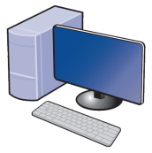
Virtual LANs (VLANs)
Simple single-switch example
VLAN 10
VLAN 20
1 | 2 | 3 | 4 | 5 | 6 | 7 | 8
Layer-3 Switch Ports

Slide 19
Virtual LANs (VLANs)
Multiswitch VLANs
L3-switches communicate using inter-switch protocols that support VLANs
VLAN trunks are circuits that connect two VLAN switches
VLAN tag inserted into Ethernet frame (e.g., 802.1Q) or encapsulates frame (e.g. ISL)
Preamble & Delimiter
(8 bytes)
Destination Address
(6 bytes)
Source Address
(6 bytes)
802.1Q Header
(2 bytes)
Type
(2 bytes)
Data
(46-1500 bytes)
CRC
(4 bytes)

Slide 20
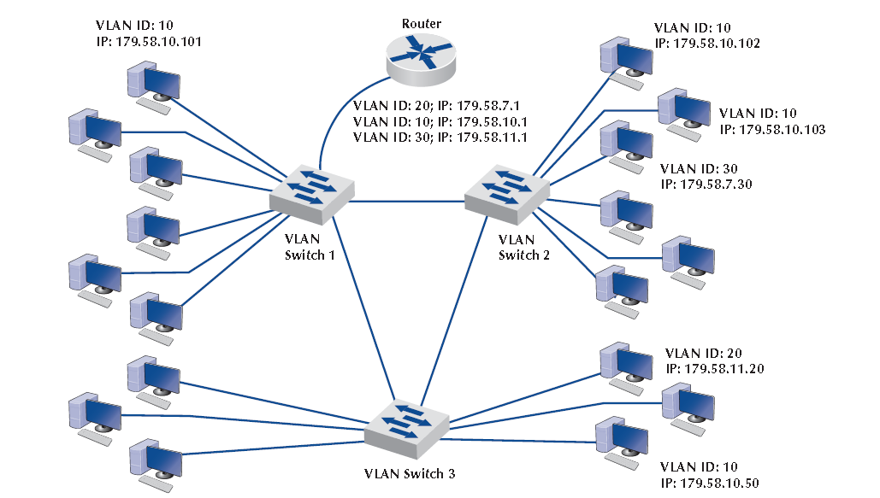
Virtual LANs (VLANs)

Slide 21
Virtual LANs (VLANs)
Advantages
More flexible subnetting
Better managed traffic flow which may lead to faster performance
Traffic prioritization
Can include quality of service information in tag
Disadvantages
Complex
May increase management when VLAN memberships change
Layer 3 switches are more costly than L2

Slide 22
Best Practices
Architecture
Switched has best cost to performance ratio at the distribution layer
Most organizations use routed at the core layer
VLANs are becoming more widely used, especially for organizations needing the flexibility
Technologies
Gigabit Ethernet for distribution layer
Gigabit Ethernet or faster for core layer
Redundant devices and connections

Slide 23
Best Practices

Slide 24
Improving Backbone Performance
Devices
Circuits
Demand

Slide 25
Implications for Management
Cost and necessity of upgrading BNs will grow as demand increases
VLAN backbones provide flexibility and are becoming increasingly popular
As with LANs, Ethernet is now the predominant protocol in BNs

